Slide 1
DeVOPS READINESS
ATLC Ghost Switch DevOps Team
(Ken Chenis, Prashant Kulkarni, Mark Newsom, Adrian Florea, Jeannie Sargent, Eric Gieseke)
July 2016

Slide 2

Overview
DevOps Readiness
Multistep and ongoing process/journey
Current Scope
Deployment Automation
Future Scope
Source Code Management
Test Automation
Infrastructure/Health Monitoring
…

Slide 3
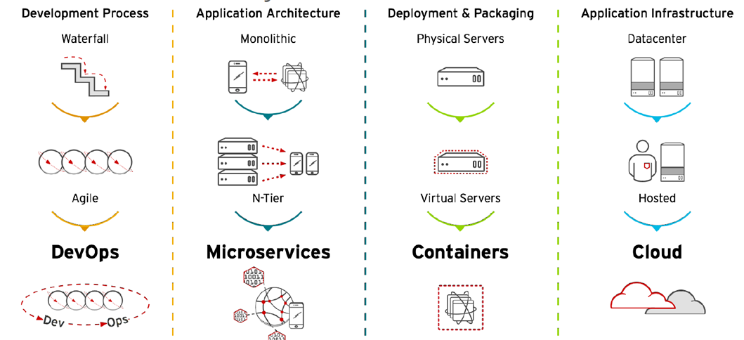
IT Evolution

Slide 4
Deployment Automation Maturity Phases
Manual setup & configuration
Slow and inefficient
No repeatability or reliability
Partial Automation possible
Apps installed as immutable containers
Externalized configurations
Static scalability
Dynamic scalability on demand
Supports daily releases
High Availability
Fault Tolerant
Supports Disaster Recovery
Meets SLAs
LEVEL 4
Multisite
Deployment
LEVEL 3
Orchestrated
Deployment
LEVEL 2
Containerized
Deployment
LEVEL 1
Manual
Deployment

Slide 5
LEVEL 1
Manual Deployment

Slide 6
Overview
LEVEL 1
Manual
Deployment
Traditional Software deployment
Typical process involves pre-install steps
JAVA installation
App server installation
Database installation
MQ installation
Software installation involves manual steps to configure and deploy the apps
Drawbacks
Amount of time for setup (days or weeks)
Does not scale automatically if newer capacity is needed
Patching/new version rollout is not supported without downtime
Error prone

Slide 7
Deployment Automation: Technology Advances
Deployment Automation is made much more simplified, quick and repeatable via recent advancement in technology.
Docker based systems offer several advantages
Portability
Speed
Abstraction
Security
Efficiency
Virtual Multitenancy
(For more info please see appendix)
However…
The Docker ecosystem is maturing. So careful evaluation and validation is necessary.
It comes with new changes needed in the existing products to comply with the guidelines.
Google runs everything in a container. Typically 2 billion containers are started every week.
- 2014 publication

Slide 8
LEVEL 2
Containerized Deployment

Slide 9
Overview
LEVEL 2
Containerized
Deployment
Main goal is quick deployment and static scalability.
Apps are installed via standard Docker containers
Configuration settings are all externalized making it easy to configure and deploy the artifacts. Configuration values are provided at runtime
Ops team doesn’t need to understand the specifics of the application but only how to specify env specific configuration values
Some aspects of applications (like databases) may still be managed outside containers though AOD is increasingly in favor of 100% containerization.

Slide 10
Steps
LEVEL 2
Containerized
Deployment
1.Identify Deployment Components
2. Support continuous and efficient build process
2a. Create component builds
2b. Configure distributed builds
2c. Execute testcases as part of the builds
3. Build Docker images
3a. Identify components to dockerize
3b. Create smaller container images
3c. Include the runtime dependencies
3d. Document operational and configurable characteristics
4. Create immutable images
4a. Externalize environment specific configurations
4b. Standardize configuration via placeholders
4c. Allow overrides via environment variables
4d. Provide mechanism to alter/refresh runtime config.
5. Maintain the Docker image registry
6. Use automation scripts for the deployment

Slide 11
1. Identify Product Deployment Components
LEVEL 2
Containerized
Deployment
Review the deployment architecture for the product
Identify the independent components/deployment units that could be independently assembled, shipped and deployed.
Some examples of components are
War files
Standalone java programs
Executables on native platform
Databases
Queues
File stores

Slide 12
2. Support continuous/efficient build process
LEVEL 2
Containerized
Deployment
Create Continuous Build and Integration infrastructure via Jenkins and GIT (preferred over SVN)
Optimize the build infrastructure for efficiency and quality.
Faster build times lead to shorter turn around cycle.
The sooner the defects are detected, less costly they are.

Slide 13
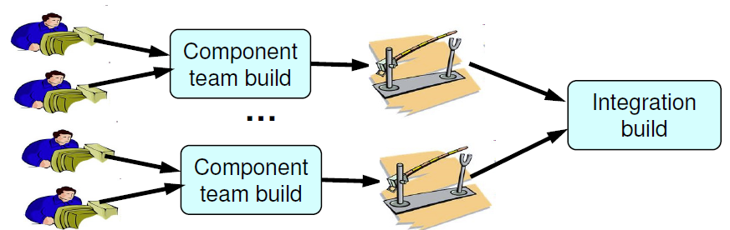
2a. Create component builds
LEVEL 2
Containerized
Deployment
To maximize the efficiency and scalability, there should be separate and independent component builds. These build should be trigger automatically whenever component code changes.
Integration Build should then bring multiple components together and perform integration tests. These could be automatic or scheduled/nightly builds.

Slide 14
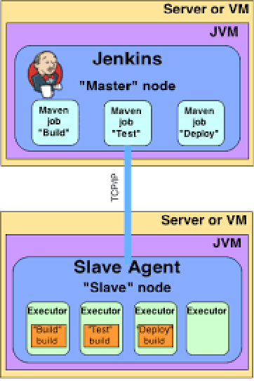
2b. Configure distributed builds
LEVEL 2
Containerized
Deployment
Jenkins supports master-slave mode where the workload of building projects are delegated to multiple "slave" nodes, allowing a single Jenkins installation to host a large number of projects, or to provide different environments needed for builds/tests.
Follow this mechanism to make sure that component builds could be run in parallel of each other.

Slide 15
2c. Execute testcases as part of the builds
LEVEL 2
Containerized
Deployment
Run the unit tests as part of the component builds. Declare the build as a failure if the unit tests fail.
Run the integration tests as part of the integration tests. Declare the build as a failure if the integration tests fail.

Slide 16
3. Build Docker images
LEVEL 2
Containerized
Deployment
Currently, the builds produce the artifacts like war files, jar files etc.
The Docker images should be built as part of the build output that package one or more build output artifacts in the right manner.

Slide 17
3a. Identify components to containerize
LEVEL 2
Containerized
Deployment
Typically the artifacts like war file, jar files and native applications are good candidates to dockerize. The portability and scalability aspects supported by docker make it ideal for dockerize those components.
Databases:
Database containers are easy to build and deploy. (Links: oracle container, db2 container) However when the container is destroyed, the data is lost.
Docker supports mounting persistent volumes inside container. DBMS containers could be created with this mechanism so that data could be persisted even though container is shutdown.
The DB container mechanism is very useful for dev and test environments since the setup could be performed very quickly.
For production setup, we are not recommending the DB containers since there is no formal support from Oracle for docker containers and technology has not matured to the degree we need.

Slide 18
3a. Identify components to containerize (contd)
LEVEL 2
Containerized
Deployment
Queues:
Expectations from Queues like WebSphere MQ and Active MQ are very similar to databases.
It is recommended that we can use queue images for dev and testing use.
IBM provides containerized image of MQ for production use Link. But since the queues rarely change, it is up to us whether to use containerized version
Disk/FileStores:
Some of the ACI applications make use of file based data storage.
It is recommended that they make use of volume mounting capabilities to a network location as a way to maintain and preserve the data.
You can find useful info about stateful data management in docker here. You can also find some patterns for persistent data storage.

Slide 19
3b. Create smaller Container Images
LEVEL 2
Containerized
Deployment
Docker engine, multicore processors and modern OS are optimized to handle multiple processes simultaneously rather than one resource intensive process in terms of CPU and memory use.
Smaller containers provide several benefits
Ability to scale the container independent of others
Ability to update/deploy container independently
Ability to monitor resource utilization (CPU, memory etc) per container
Docker container images should then be based from components based on your scalability and service/functional coherency needs.
It is typical for images to contain only one war file. You might choose to deploy multiple war files under one container if you feel that scalability and deployability needs may not get impacted by this packaging. But this should be an exception than a rule.

Slide 20
3c. Include the runtime dependencies
LEVEL 2
Containerized
Deployment
Images should be packaged in such a way that they have minimum little external runtime dependencies
This helps easier ways to scale and deploy them without worrying about underlying infrastructure.
Thus guarantees that the images that works in dev setup also works on production setup in the most reliable manner.
Component Type | Docker Image Constituents
War file | Application server + Java runtime + war file at the appropriate location in the deployment directory
Jar file | Java runtime + Jar file + other third party libraries
Database | Database server + data directory that should be mounted/imported at the runtime
Native executable | Include whatever is needed to run that executable

Slide 21
3d. Document operational & configurable characteristics
LEVEL 2
Containerized
Deployment
Document all the operational characteristics for the image for successful instantiation.
Items to be documented
Name/Version of the image
Functionality supported
Type (native app/web app/java app/database)
Ports to be exposed
External dependencies/external links details
Persistent Volume Mounting Requirement
Env variable overrides supported
Other characteristics of interest

Slide 22


4. Create immutable images
LEVEL 2
Containerized
Deployment
We would be creating one image that works across the environments. This guarantees that the image that was tested in one env will work in production environment.
Based on the environment we could optionally supply different configuration values but the image remains the same.
Immutable
Docker
Image
Dev
Env
Test
Env
Prod
Env

Slide 23
4a. Externalize environment specific configs
LEVEL 2
Containerized
Deployment
All external dependencies and configuration parameters of the application components need to be captured in the configuration files. Some of the examples of configuration files will be
Key-Value pair format
XML format
JSON format

Slide 24
4b. Allow overrides via environment variables
LEVEL 2
Containerized
Deployment
Application should allow reading those values from the environment variables and then overriding the defaults with these values.
Examples:
To refer to entitlement provider…
Incorrect: bsicontext.AuthenticationReceiver.url=bsi:tcpip// cov3lmtsupfdev07vm:3133
Correct: entitlementsProvider.bsicontext.AuthenticationReceiver.url=bsi:tcpip//${ENT_PROVIDER}:3133
Some of the examples where this technique should be used is
Database connection strings/passwords
Debug log levels
Compression Policy
.

Slide 25
4c. Specify configuration via overlay networking placeholders
LEVEL 2
Containerized
Deployment
The configuration files should contain generic server names rather than hardcoded server names or ip address.
Examples:
To refer to database server…
Incorrect: apsfmain.jdbc.url=jdbc:oracle:thin:@cov3lmtsupfdev07vm:1521:XE
Correct: apsfmain.jdbc.url=jdbc:oracle:thin:@dbserver:1521:XE
To refer to the bsi property…
Incorrect: bsicontext.AuthenticationReceiver.url=bsi:tcpip//cov3lmtsupfdev07vm:3133
Correct: entitlementsProvider.bsicontext.AuthenticationReceiver.url=bsi:tcpip//entitlementprovider:3133
Then we can rely on the network to resolve the hostnames like dbserver and entitlementprovider at runtime in the target environment.
Docker Compose and other tools support creation of overlay network and this requirements is easily met.
.

Slide 26
4d. Provide mechanism to alter runtime config
LEVEL 2
Containerized
Deployment
Business or operational requirements might dictate your application to support updating the config dynamically (without restart). Examples:
Log level might need to be altered
Zipkin based instrumentation might need to be started/stopped
Typically this would be done via periodically monitoring config settings on a file or database.
Applications should provide and document such dynamic configuration on need basis
.

Slide 27
5. Maintain the Docker image registry
LEVEL 2
Containerized
Deployment
Successful builds should create docker images for the components being deployed
Images should be pushed and maintained in a Docker registry along with the information mentioned in earlier guidelines.
Registry should be specific to a product/group to maintain the ownership issues. Eventually we can look into a common/corporate Docker registry across the products.
Further because of governance/access control issues, we can separate the docker registries used in dev/test environment vs production environment.

Slide 28
6. Use automation scripts for deployment
LEVEL 2
Containerized
Deployment
At this stage all the prereqs for deployment should be met.
Create automation scripts to deploy the solution
Identify additional env information to be provided to the containers
Identify right order and naming for the containers
Identify the log directory and ports
Mount the log directory to a directory outside container for persistence
Create docker compose scripts that captures the above mentioned information
Run the script and make sure that the images are downloaded and containers run properly.

Slide 29
Level 2: Summary
LEVEL 2
Containerized
Deployment
Apps are installed via standard Docker containers
Scalability is achieved manually by deploying fixed set of containers.
Deployment is automated but patching/upgrades still needs manual intervention
Load balancing could be done but needs manual configurations

Slide 30
LEVEL 3
Orchestrated Deployment

Slide 31
Overview
LEVEL 3
Orchestrated
Deployment
Main goal is dynamic scalability and daily deployments with high availability
Apps are installed via standard docker container orchestration tools
Orchestration engine deploys containers based on demand/resource availability
Load balancing and high availability resiliency is achieved via infrastructure rather than application features

Slide 32
Steps
LEVEL 3
Orchestrated
Deployment
1.Scalability Support :
1a. Identify and address horizontal scalability aspects
1b. Use infrastructure level auto scaling tools
2. Automated Rollout and rollback (Scheduling):
2a. Support Blue Green Deployment
2b. Support for Canary Deployment is desirable
3. Service Discovery:
3a. Use fault-tolerant Service Registry
3b. Service Self-registration is discouraged
3c. Use “third party service registration” pattern
4. Overlay Network, Proxy and Load Balancing:
4a. Create overlay network if needed
4b. Use proxy service for external requests
4c. Use proxy service for internal requests
4d. Update proxy configuration dynamically

Slide 33
1. Scalability Support
LEVEL 3
Orchestrated
Deployment
Identify the scalability requirements from the solution
TPS
Response times
Data storage quantity
Work out the implications at the component level

Slide 34
1.1 Identify and address horizontal scalability aspects
LEVEL 3
Orchestrated
Deployment
Use some of the techniques/best practices mentioned in links below to bridge the gaps
12 factor apps Link
12 factor apps in plain English Link
Typically scalability to a higher degree is NOT achieved unless the applications are made “stateless”.
The state of your system is completely defined by your databases and shared storage, and not by each individual running application instance.

Slide 35
1.2 Use infrastructure level autoscaling tools
LEVEL 3
Orchestrated
Deployment
Scalability could be achieved by spanning new application instances
This could be better achieved via docker orchestration solutions like
Docker swarm
Kubernetes
OpenShift
(Final recommendation is TBD)
The deployment configuration could be further “tuned” based on parameters like
CPU-shares
Memory usage
Number of containers etc
More information could be found in the sections below
Docker filters
Docker strategy

Slide 36
2. Scheduling (automated rollout and rollback)
LEVEL 3
Orchestrated
Deployment
Identify the exact mechanism to deploy/rollout new version of app
Image updates
Database updates
Identify rollback strategy that would allow smooth fallback mechanism
Image rollback
Database compatibility Issues
Any other items

Slide 37
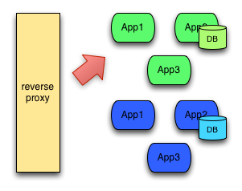
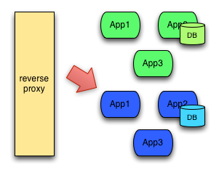
2a. Support Blue Green Deployment
LEVEL 3
Orchestrated
Deployment
Deployment uses 2 separate environments (blue and green). The router/load balancer/proxy decides which environment to use. Link to original article

Slide 38
2a. Support for Blue Green Deployment (contd)
LEVEL 3
Orchestrated
Deployment
This deployment pattern might look easier to implement. But we need to look for several items listed below -
Long running sessions/transactions in the green environment.
When you switch over to blue, you have to gracefully handle those outstanding transactions as well as the new ones. This also can become troublesome if your DB backends cannot handle this (see below)
Enterprise deployments are not typically amenable to “microservice” style deployments
We will have a hybrid of docker style apps, and some traditional, difficult-to-change-apps working together. Coordinating between the two for a blue-green deployment can still lead to downtime
Database migrations can get really tricky
All database changes need to be backward compatible to support rollbacks
Database changes would have to be migrated/rolledback alongside the app deployments. There are good tools and techniques for doing this, but in an environment with traditional RDBMS, NoSQL, and file-system backed DBs, these things really need to be thought through & tested ahead of time
You need to have duplicate infrastructure to do this

Slide 39
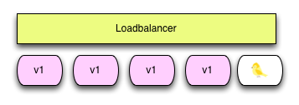
2b. Support for Canary Deployment
LEVEL 3
Orchestrated
Deployment
Deployment uses a new version of your app into production that plays the role of a “canary” to get an idea of how it will perform in terms of important aspects like CPU, memory, disk usage and integration aspects.

Slide 40
3. Service Discovery
LEVEL 3
Orchestrated
Deployment
Each new instance of a service (or application) to be able to identify its current environment and use that information.
Service Discovery Infrastructure supports following process
Service Registration: Process that stores, as a minimum, the host and the port of a service
Service Discovery: Process that allows a services to discover information about the other services

Slide 41
3a. Use fault-tolerant Service Registry
LEVEL 3
Orchestrated
Deployment
Since the discovery is often used in distributed system, registry needs to be scalable, fault-tolerant and distributed among all nodes in the cluster.
The primary usage service information is to provide, as a minimum, IP and port of a service to all interested parties that might need to communicate with it. This data is often extended with other types of information.
Service Registry data storage is usually in key/value format.
Based on our research, the service registry could be best realized via existing open source tools
Etcd
Consul

Slide 42
3a. Service Self-registration is discouraged
LEVEL 3
Orchestrated
Deployment
Advantages:
Self-registration the easiest mechanism to implement.
Drawbacks:
The registration code needs to be added in each service.
Deregistration is hard if the service is slow or dies accidentally.

Slide 43
3b. Use “third party service registration” pattern
LEVEL 3
Orchestrated
Deployment
Advantages:
More reliable
Avoids unnecessary coupling
Can trigger alerts/manageability events
Registrator can directly monitor docker logs to understand health of container
Drawbacks:
Additional infrastructure component
Based on our research, the tool registrator (open source tool) might be an ideal fit for the registration needs

Slide 44
4. Use Proxy Services
LEVEL 3
Orchestrated
Deployment
A proxy service is a service that acts as an intermediary between clients performing requests and services that serve those requests.
A client sends a request to the proxy service that, in turn, redirects that request to the destination service thus simplifying and controlling complexity laying behind the architecture where the services reside.
A reverse proxy is a type of proxy service that is usually used to control and protect access to a server or services on a private network. Besides its primary function, a reverse proxy often also performs tasks such as
Load-balancing
Decryption
Caching
Authentication.

Slide 45
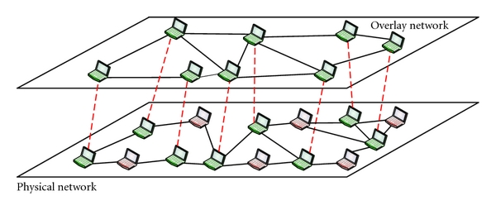
4a. Use overlay network
LEVEL 3
Orchestrated
Deployment
As new containers come online, they need to be assigned new ip addresses.
The number of containers can significantly grow.
The orchestration tools support creating a new overlay network. This makes it easy to make routing decisions

Slide 46
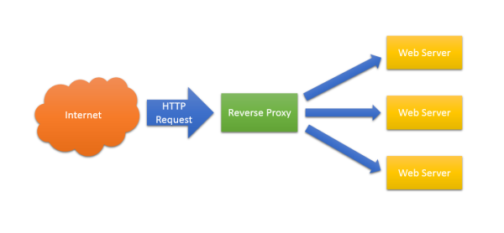
4b. Use API gateway/proxy for external requests
LEVEL 3
Orchestrated
Deployment
External callers should not be allowed to access the application servers/services directly. In order to support HA and load balancing capabilities, front end proxy should be used.
It is also advisable to enforce security and QoS policies at the proxy level so that the services are not impacted.
Several commercial solutions in the form of API gateway already exist that support these features.

Slide 47
4c. Use proxy service for internal requests
LEVEL 3
Orchestrated
Deployment
As the number of services increase, it becomes very important to apply load balancing techniques for internal communication (service to service)
Rather than letting one service directly invoke another service via servernames/ip addresses directly, it should refer to the other service via proxy specific (indirect) url.
The proxy will then forward request to the right service instance and also use right load balancing strategy to spread the load accordingly.
This will guarantee failover, load balancing and high availability for internal needs.
The leading candidates for proxy service are
HA Proxy (managed by apache)
NGINX (open source)

Slide 48
4d. Update proxy configuration dynamically
LEVEL 3
Orchestrated
Deployment
The proxy also acts load balancer. So it is very important that it relies on right info in real time.
Consul coupled with registrator can work with proxy solutions like HAProxy and NGINX to realize the dynamic proxy solutions.

Slide 49
LEVEL 4
Multi site Deployment

Slide 50
TBD
More info TBD

Slide 51
DEVOPS PIPELINE

Slide 52

DevOps Pipeline Vision
Developer
Ops
Release Manager
Dev/QA Manager
Ops
Manager
SCM
CI/CD Tool (e.g. Jenkins)
1Trigger
Build Code/Image
Promote as
QE/UAT Drop
Promote as Release Drop
Promote as Prod Drop
2 Push Artifact
3.Push
5.Tag
7.Pull
8.Push
10.Tag
Maven Repo Manager
Internal Image Registry
Prod Image Registry
4.Pull Image
6.Pull Image
9.Pull Image
11.Pull Image
Dev Env
QE/CITEnv
UAT
Env
Prod
Env
DEV Team
QE Team
Ops Team
Notes:
Put in flows and show flow rather than static view

Slide 53
BACK UP SLIDES

Slide 54
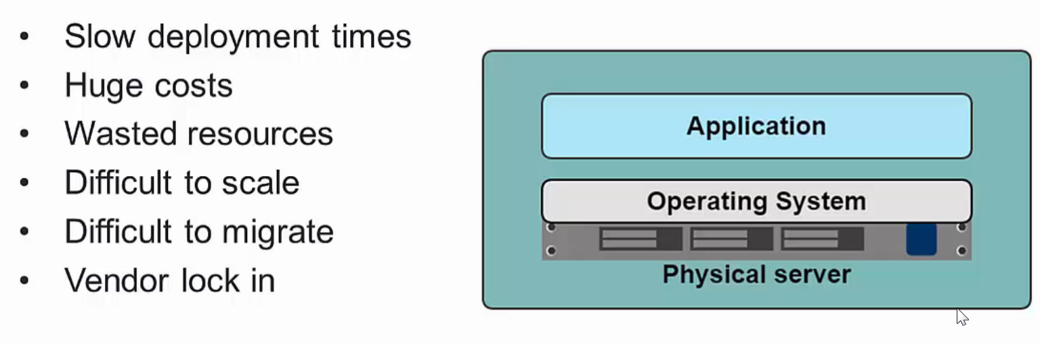
Traditional Machine Setups

Slide 55
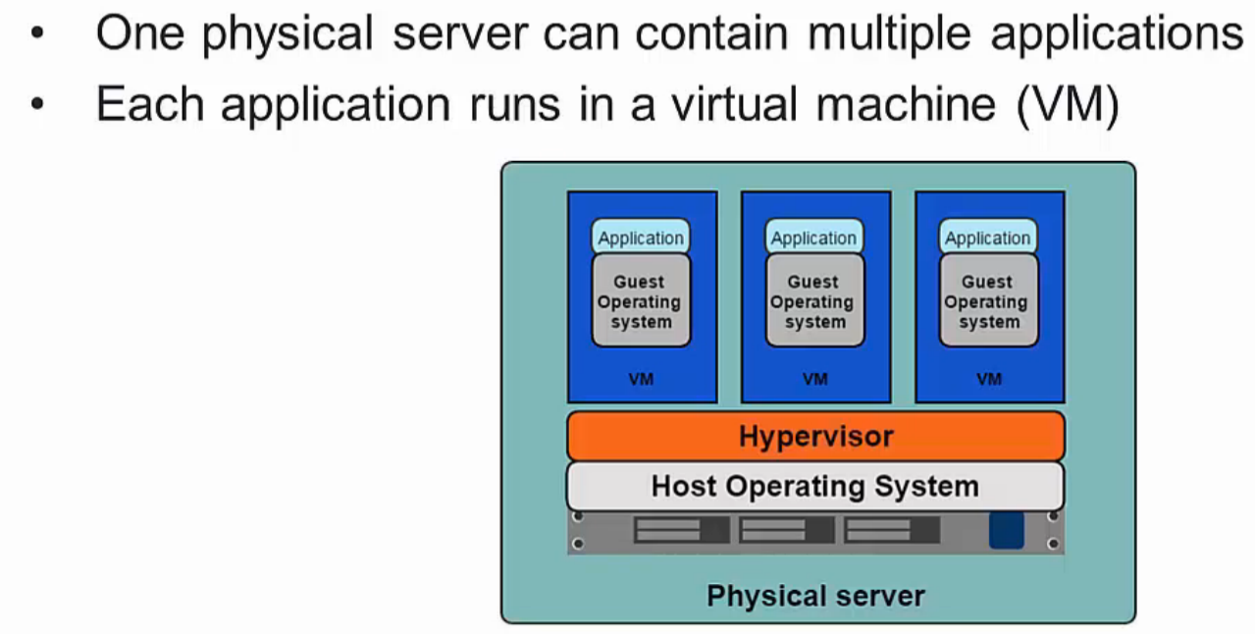
Virtualized Environment

Slide 56
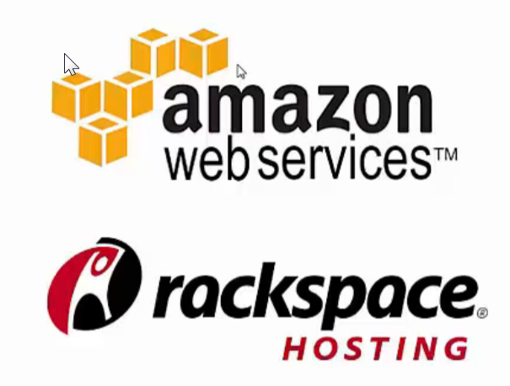
Benefits of VM
Better resource pooling
One physical machine shared among various virtual machines
Easier to Scale
Supports backups/ restore
Support on the cloud/data center
Rapid Elasticity
Pay as you go model

Slide 57
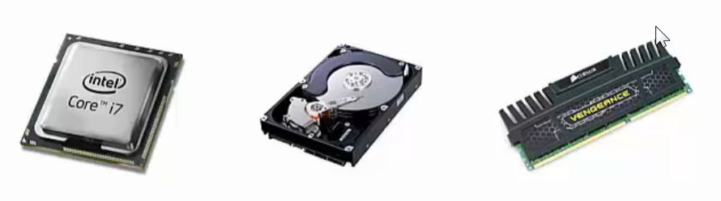
Limitations of VM
Each VM still requires
CPU Allocation
Storage
RAM
Entire guest OS
Wasted resources and Complex Configuration
More VMs you run, more resources you need outside application
Hard to allocate resources to a specific VM on demand
Vendor lock-in
No API standardization

Slide 58
Introducing Containers
The key difference between the container setup and VM based setup is that container-based virtualization uses the kernel of the host OS to run multiple isolated guest instances. These guest instances are called Containers.
By making use of the host operating system’s kernel and not relying on a hypervisor to manage resources, the container stack is far more lightweight than other solutions.
It also allows for completely isolated instances. Each container has its own root filesystem, processes, memory, devices, and network interface.

Slide 59
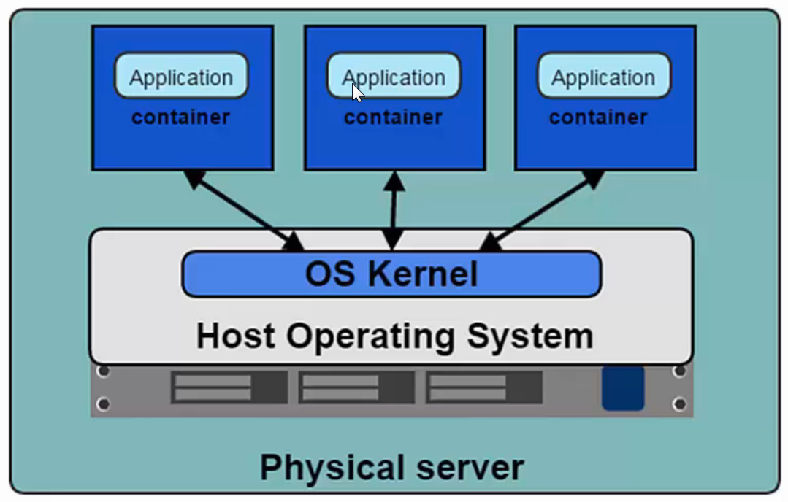
Introducing Container
Containers are the products of operating system virtualization.
Each container has its own
Root file system
Processes
Memory
Devices
Network Ports

Slide 60
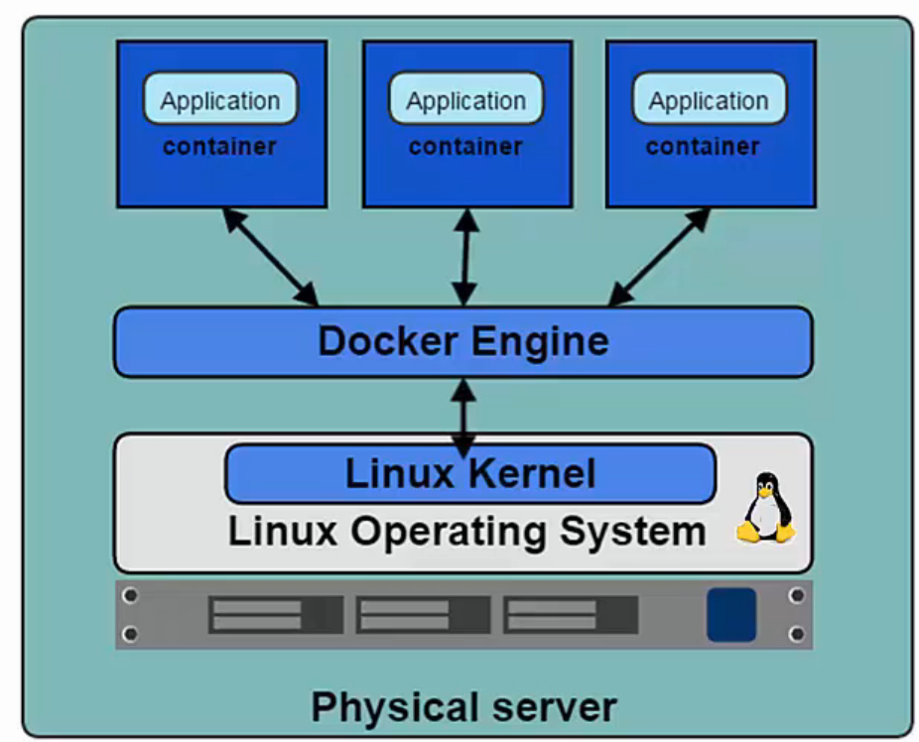
Introducing Docker
Docker is the de facto standard for application containers.
Docker Engine is the program that allows containers to be built, shipped and run
Docker uses Linux Kernel namespaces and control groups and provides isolation

Slide 61
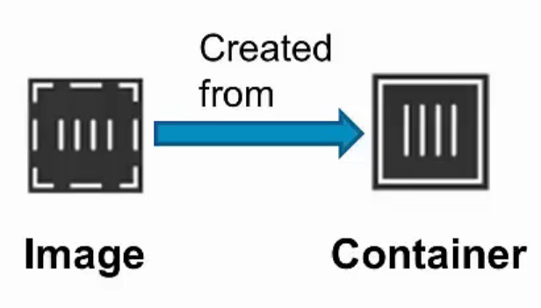
Docker Containers and Images
Images
Read-only templates to create containers
Built by any user
Stored in a common registry for sharing the images
Docker Hub: app store for images
Containers
Isolated, resource controlled and portable operating environment
Contains everything that you need to run app

Slide 62
Advantages of Docker
Application Portability:
Docker allows you to package an application with all of its dependencies into a standardized unit for software development.
Built in one platform and ship to another one
Eliminates ‘snowflake server’ situations
Portability from bare metal to VM to private cloud to public cloud
Speed:
Setup | Start Time | Stop Time
Docker Containers | < 50ms | < 50ms
Virtual Machines | 30-45 s | 5-10 s

Slide 63
Advantages of Docker
Additional Level of Abstraction
With Docker one can separate applications from infrastructure and treat infrastructure like a managed application.
Container becomes common abstraction layer (e.g. support multiple app servers)
Improved Resiliency and Robustness:
Swarm/Kubernetes based clustering/orchestration layer can help
Moving the responsibility from application/framework to platform
Enhanced Security/Governance:
Containers are immutable and provide level of abstraction from OS
Image registry helps with traceability/auditing around the image download and usage.

Slide 64
Advantages of Docker
Environment Consistency:
Prebuilt configuration/ lesser configuration needs
Easier upgrades by container replacement
Improved compute utilization/density:
Better control over resources and scaling needs
Higher infrastructure sharing
Virtual Multi-tenancy:
Better isolation and sandboxing can be used to create virtual multi-tenancy

Slide 65
Docker Orchestration
Docker Machine
Tool that provisions Docker hosts and installs Docker engine on them.
Docker Swarm
Tool that clusters many Docker Engines and schedules containers
Docker Compose
Tool to create and manage multi-container application.

Slide 66
Bringing it all together

Slide 67
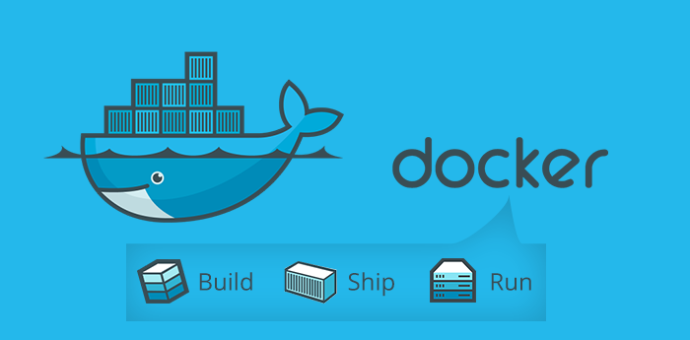
Thank You !

